Slide 1
Youth & Food Benefit Assistance
How to Combat the Stigma.
Summer Institute Conference Tucson, AZ
May 31st, 2017
Natalia B. Santos, MPH Food Systems Program Coordinator University of Arizona Nutrition Network
Notes:
1hr 15min
Present for 30-40 minutes
Talk in small group 10 minutes
Big group 20 minutes

Slide 2
Topics
A glance at food benefits and who uses them
How do food benefits fit into a school environment
Stigma and its impact
How to combat stigma
Community Resources
Getting students involved
Notes:
Glance at food benefits and who uses them
How do food benefits fit in a school environment
Stigma and its impact
How to combat stigma (not a feeding site, activity & free food, Dos and Donts)
Community Resources
High school students getting involved (volunteer or mentoring) -

Slide 3
What are food benefits?
SNAP- Supplemental Nutrition Assistance Program¹
≈999,400 people in Arizona on SNAP.
Serves 67.9% of those eligible for benefits.
Every $1.00 in SNAP benefits = $1.80 in total economic activity.
WIC- Supplemental Nutrition Program for Women, Infants, and Children²
Pregnant, breastfeeding, and postpartum women; infants.
Children under the age of five who are determined to be at nutritional risk.
Since January 2017, WIC has served over 150,000 women and children.
Notes:
SNAP- Supplemental Nutrition Assistance Program¹ (used to be called food stamps, and the change was due to improve the image)
In Fiscal Year 2015, SNAP provided about $1.46 billion dollars in food benefits to a monthly average of 999,401 people in Arizona.
The program served 67.9 percent of those eligible for benefits in Arizona in 2014.
SNAP also has an economic multiplier effect; every dollar in new SNAP benefits results in $1.80 in total economic activity
WIC- Supplemental Nutrition Program for Women, Infants, and Children²
WIC serves pregnant, breastfeeding, and postpartum women; infants; and children under the age of five who are determined to be at nutritional risk.
Since January 2017, WIC has served over 150,000 women and children
Food Insecure: Household is uncertain of having, or unable to acquire, enough food to meet basic needs for all household members at some time during the year because they can not afford enough food.

Slide 4
Food Assistance and Nutrition programs in Schools
In 2015-16 school year, 58% of children approved for free or reduced-price lunches in AZ^{3,4}
2016 Child Poverty⁵
National- 19.7% AZ- 25.5%
Almost all schools in Pima partake in some kind of food assistant and nutrition program
National Free & Reduced School Lunch & Breakfast Program
Child and Adult Care Food Program (CACFP)- After School Care Snack Program
Summer Food Service Program
Notes:
Percentage of children younger than 18 years who live in households at or below the poverty threshold National average- 19.7% AZ average- 25.5%

Slide 5
Household members who work in the past 12 Months:
0 members = 19.4%
1 member = 45.4%
2 or more members= 35.2%
Notes:
2016 data for Tucson’s congressional district 2
There is a lot of misconceptions on who uses food assistance programs, one of them being work status of SNAP participants.
Less than 20% of SNAP households have 0 family members working. This number also includes retired seniors, individuals with disabilities, and others incapable of working.
Over 80% of SNAP households have working family members.

Slide 6
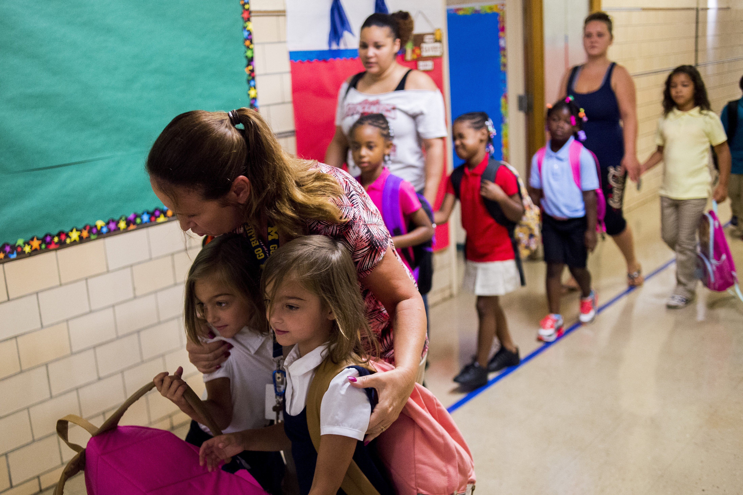
Stigma and its Impact
“… individuals' negative attitudes toward welfare decrease the likelihood of applying for food stamps/SNAP” ⁶
“...food stamp/SNAP benefits reduce household food insecurity and the negative health outcomes associated with it”⁶
Notes:
Negative stigma of the utilization of food assistance keeps families/parents, from applying to these services. When parents don’t apply, kids end up feeling the impact.
“Results of our (Brizmohun, R., Duffy, P., 2016 study provide evidence that individuals' negative attitudes toward welfare decrease the likelihood of applying for food stamps/SNAP. Among families with children, those with high stigmatization were found to be about half as likely to report ever having applied for food stamps as those with less negative views. These findings are important because research has shown that food stamp/SNAP benefits reduce household food insecurity and the negative health outcomes associated with it”
Brizmohun, R., Duffy, P., 2016 Do Personal Attitudes about Welfare Influence Food Stamp Participation?
http://ageconsearch.tind.io//bitstream/235698/2/Do%20Personal%20Attitudes%20about%20Welfare%20Influence%20Food%20Stamp%20Participation.docx.pdf

Slide 7
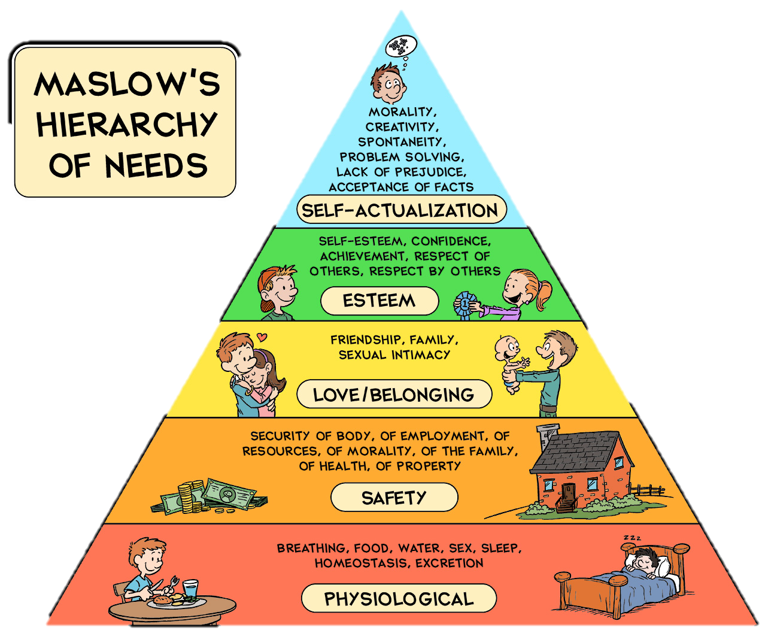
Self-fulfillment Needs
Psychological Needs
Basic Needs
Notes:
Maslow stated that people are motivated to achieve certain needs and that some needs take precedence over others. Our most basic need is for physical survival, and this will be the first thing that motivates our behavior.
One must satisfy lower level needs before progressing on to meet higher level needs. When we have met our basic needs, we then can move up to meet our psychological needs, and self-fulfillment needs.
Food is a basic need. We can’t expect a person to move up the pyramid when they are still figuring out when is their next meal. “Children from families that report multiple experiences of food insufficiency and hunger are more likely to show behavioral, emotional, and academic problems on a standardized measure of psychosocial dysfunction than children from the same low-income communities whose families do not report experiences of hunger”
Kleinman RE, Murphy JM, Little M, et.al. 1998. Hunger in children in the United States: potential behavioral and emotional correlates. Pediatrics Journal. Jan;101(1):E3.

Slide 8
External vs. Internal
Minimal
vs.
Optimum
Basic Right vs. Charity
Physiological Needs
vs.
Self-Esteem
Cost vs. Benefits
Notes:
WHAT’S HAPPENING ON THIS SLIDE?

Slide 9
Where do we see it? how do we feel it? ⁷
Dynamics of stigma most vividly operate through face-to-face interaction.
Stigma can be self-afflicting. Participants believe that engaging in actions is self-deprecating.
Feelings of stigma are dependent on the audience, the specific situation and the individual’s life history.
Notes:
Dynamics of stigma most vividly operate through face-to-face interaction
Conversations we have with others, things we overhear or are told to us.
Stigma can be self-afflicting. Participants believe that engaging in actions is self-deprecating.
Once we believe something is a socially frowned upon, we chose not to partake in it. This is also in relation to pride. We don’t want others to see us when we’re down, and even going to the DES office, or the free-lunch line/site, can be a challenge.
Feelings of stigma are dependent on the audience, the specific situation and the individual’s life history.
Stigmatization and its impact is more dynamic and fluid than has been recognized. Some people may be perfectly OK talking about receiving assistance in some places or with some people, and avoid it completely in other situations. A student can be ok with being in the food line, and then see something or hear something and change their opinion completely.
People feel and learn about stigma in multiple different ways whether we know it or not. So it’s important for us as adults in these environments to keep our ears and eyes open for learning opportunities, where we can step in and help out.

Slide 10
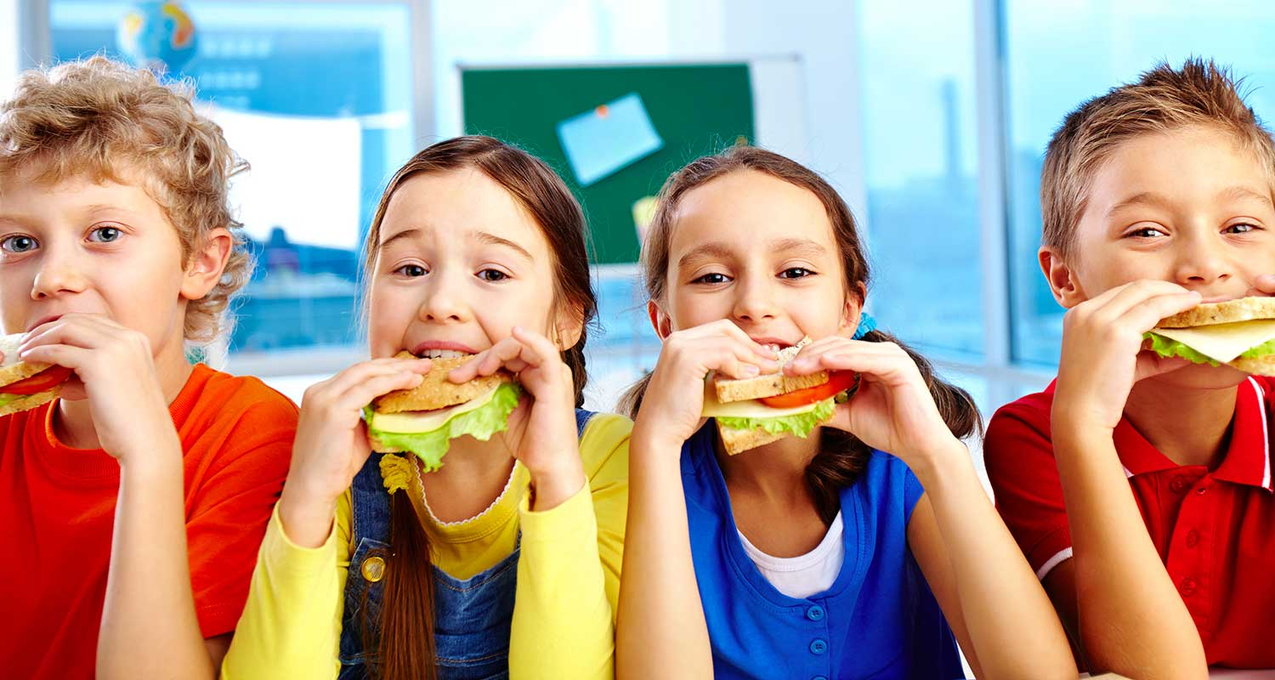
But what about the kids?

Slide 11
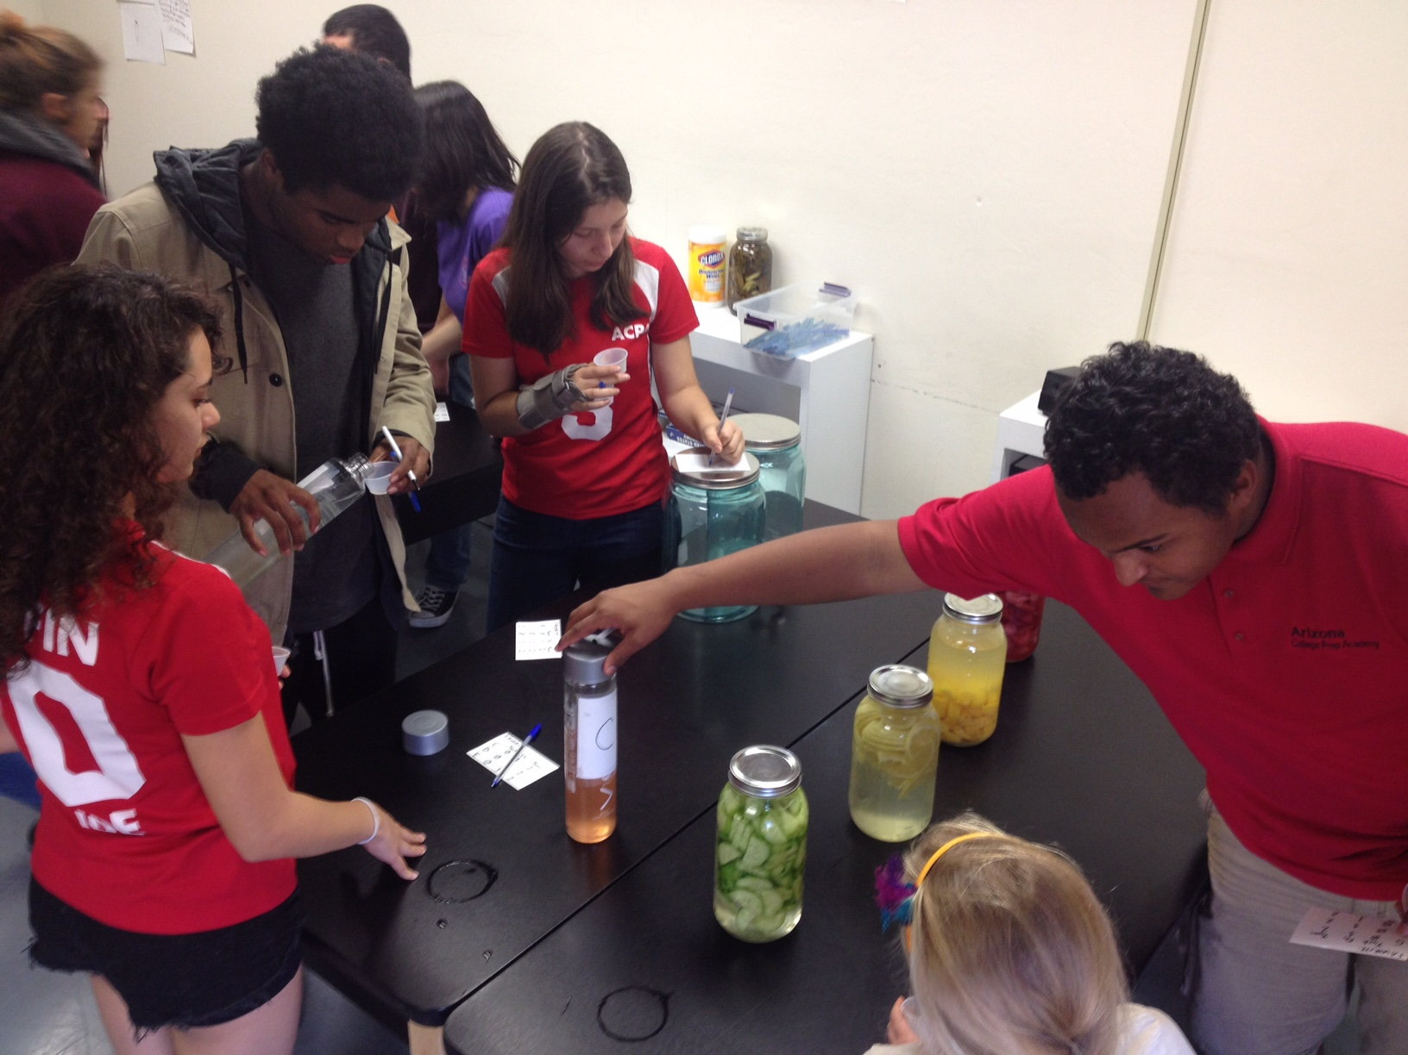
But what about the kids
Teenagers?
Notes:
We talk a lot about kids… let’s talk about our teenagers.

Slide 12
What we know…
…Teenagers are a different animal
Develop stronger reasoning skills, logical and moral thinking, and become more capable of abstract thinking and making rational judgements.⁸
External influences shape their lives. ⁸
include social values and norms
the changing roles, responsibilities, relationships and expectations of this period of life
Notes:
All societies recognize that there is a difference between being a child and becoming an adult. How this transition from childhood to adulthood is defined and recognized differs between cultures and over time.
Adolescence is a time to develop knowledge and skills, learn to manage emotions and relationships, and acquire attributes and abilities that will be important for enjoying the adolescent years and assuming adult roles.
Changes taking place in the adolescent’s environment both affect and are affected by the internal changes of adolescence. These external influences, which differ among cultures and societies, include social values and norms and the changing roles, responsibilities, relationships and expectations of this period of life.
Additionally, factors from inadequate housing, food instability, and financial insecurity place stresses on young people that distract them from their studies and can cause them to disengage from school entirely. Much less worry about whether or not they are joining extra-curricular activities

Slide 13
“Regarding participation, what do you feel are the main barriers to participation in your program from the point of view of: ”⁹
Stigma attached to eating “free” food
No activity linked to the feeding program
Poor perception of the program by community members
Difficulty attracting teenagers to participate
Stigma attached to eating “free” food
Notes:
A study on why students were not participating in a summer meal program highlighted the following responses:

Slide 14
“Some high schools are finding that students would rather go hungry than be identified as recipients of free lunches” ¹¹
-Karen,S. 2008. Erasing the Stigma of Subsidized School Meals
Notes:
Note the difference (drop) between elementary school children and middle and high school students.

Slide 15
What can we do about it?
During lunch^{10,11}
Don’t… | Instead…
Don’t have different lines for cash-paying (a la cate) and free/reduced lunches. | Have all students in one line, and make paying method as smooth as possible for all.
Don’t stamps kids, or give them wristbands. | If reminders about payment are needed, send a message home separate from student.
Don’t provide different foods or service styles. | Have all foods fall under the same nutritional requirements.
Notes:
Bhatia’s response was to conduct a pilot study in three San Francisco schools in 2009 and 2010, integrating the lines by bringing competitive foods into compliance with NSLP nutritional requirements. Uniform electronic debit cards replaced segregated lunch lines and made it impossible to visually distinguish between prepaid cards and NSLP funds. The bookkeeping also changed. Whereas before, NSLP and competitive-food revenues had been lumped together, they would now be tracked independently. Federal legislation to this effect was put in place in 2010.
http://www.tolerance.org/magazine/number-48-fall-2014/lunch-lines
The results of this groundbreaking pilot study were dramatic. Participation in the NSLP increased by 58 percent, and school revenue skyrocketed. Lunch lines were similarly integrated in all San Francisco middle and high schools during the 2010–2011 school year. Bhatia calls it “the most effective and quickest advocacy work I’ve ever done.”

Slide 16
What can we do about it?
When promoting services¹²
Don’t… | Instead…
Don’t emphasize site/service as a “free food program”. | Use a holistic approach where service sites aren’t just for meals, but inclusive activities.
Don’t advertise the site/service as just for kids. | Provide volunteer, work, or mentoring opportunities for middle and high school students.
Notes:
https://www.fns.usda.gov/sites/default/files/SFSP-Innovative-Strategies.pdf

Slide 17
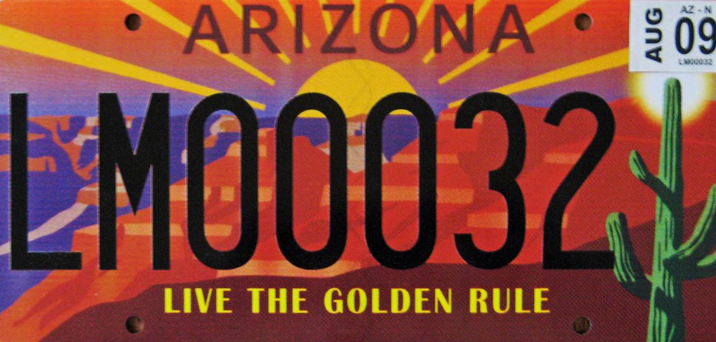
What can we do about it?
Notes:
Lead by example.
Support school changes that supports your students’ opportunity to thrive in an inclusive and safe learning and living environment.

Slide 18
Let’s talk about it…
1. What are challenges you see in your school?
2. What are ways you have combated it?
3. What additional services does your site host?
4. What are we doing that works?
5. What are we doing that can be improved?
6. What else can we do?
7. How can we be of assistance to one another? Who are possible community partners that can assist us?
Notes:
Bring your personal experiences, how working with students and schools and outside organizations .
Activity- Break into small groups and go over questions
Talk in small group 10 minutes
Big group 20 minutes
Community Partners
AZ Department of Education
AZ Department of Economic Security
AZ Department of Health Services
United Way of Tucson & Southern Arizona- Community Development
UA Nutrition Network

Slide 19
References- make them APA
SNAP Community Characteristics - Arizona. (n.d.). Retrieved April 20, 2017, from https://www.fns.usda.gov/snap-community-characteristics-arizona
Percentage of children approved for free or reduced-price lunches for School Year 2016. (2016, February 25). Retrieved April 20, 2017, from http://www.azed.gov/health-nutrition/files/2016/12/sy2016_frpercentages_publish_2.25.2016.pdfhttp://www.azed.gov/health-nutrition/
United Health Foundation. American Health Rankings. (2016, June). Retrieved April 25, 2017, from http://www.americashealthrankings.org/explore/2016-annual-report/measure/ChildPoverty/state/AZhttp://ageconsearch.tind.io//bitstream/235698/2/Do%20Personal%20Attitudes%20about%20Welfare%20Influence%20Food%20Stamp%20Participation.docx.pdf
Barr, B. M. (2000). Stigma: A Paper for Discussion. Robert Wood Johnson Foundation . Retrieved from http://www.coveringkidsandfamilies.org/resources/docs/Stigma.pdfhttp://www.who.int/maternal_child_adolescent/topics/adolescence/development/en/
Molaison, E. F., & Carr, D. H. (2005). Overcoming Barriers to Participation in the Summer Food Service Program - An Identification of Best Practice Solutions . National Food Service Management Institute–Applied Research Division. Retrieved from http://nfsmi.org/documentlibraryfiles/PDF/20090901042814.pdfhttp://www.tolerance.org/magazine/number-48-fall-2014/lunch-lines
Stein, K. (2008). Erasing the Stigma of Subsidized School Meals. Journal of the American Dietetic Association, 108(12), 1980-1983. doi:10.1016/j.jada.2008.10.021
https://www.fns.usda.gov/sites/default/files/SFSP-Innovative-Strategies.pdf
Notes:
https://www.fns.usda.gov/snap-community-characteristics-arizona
https://www.fns.usda.gov/sites/default/files/pd/27wilatest.pdf
http://www.azed.gov/health-nutrition/files/2016/12/sy2016_frpercentages_publish_2.25.2016.pdf
http://www.azed.gov/health-nutrition/
http://www.americashealthrankings.org/explore/2016-annual-report/measure/ChildPoverty/state/AZ
http://ageconsearch.tind.io//bitstream/235698/2/Do%20Personal%20Attitudes%20about%20Welfare%20Influence%20Food%20Stamp%20Participation.docx.pdf
http://www.coveringkidsandfamilies.org/resources/docs/Stigma.pdf
http://www.who.int/maternal_child_adolescent/topics/adolescence/development/en/
http://nfsmi.org/documentlibraryfiles/PDF/20090901042814.pdf
http://www.tolerance.org/magazine/number-48-fall-2014/lunch-lines
http://ac.els-cdn.com/S0002822308018993/1-s2.0-S0002822308018993-main.pdf?_tid=0961351c-26bc-11e7-8eb0-00000aab0f6c&acdnat=1492797651_7d33620d5532f7883750cde5e4d376d3
https://www.fns.usda.gov/sites/default/files/SFSP-Innovative-Strategies.pdf

Slide 20
Thank You
Natalia B. Santos, MPH Food Systems Program Coordinator University of Arizona Nutrition Network
NataliaSantos@email.arizona.edu |520-626-4920 http://www.uanutritionnetwork.org http://www.uannpima.org
The University of Arizona is an equal opportunity, affirmative action institution. The University does not discriminate on the basis of race, color, religion, sex, national origin, age, disability, veteran status, or sexual orientation in its programs and activities.

